Slide 1
Module 5
IoT Physical Devices and Endpoints

Slide 2
Module 5 Smart and Connected Cities

Slide 3
Contents
Motivation
An IoT Strategy for Smarter Cities
Smart City IoT Architecture
Smart City Security Architecture
Smart City Use-Case Examples

Slide 4
Motivation
“Most cities started as small urban centers and grew organically.
Very few of them were initially designed to immediately accommodate a very large population. Rapid growth typically strains city infrastructure.
Roads, bridges, and sewer systems often reach their maximum capacity, making access to urban services challenging.
The question of how to provide basic necessities such as water and housing while reducing the carbon footprint has begun to dominate the agendas of city planners and civic leaders everywhere.
As the world population grows, emissions and consumption also increase, the environment’s ability to absorb emissions and wastes becomes challenged.
The increasing population in a city provides an opportunity to capitalize on the city’s potential.

Slide 5
Solutions
Some solutions are discussed in following topics
An IoT Strategy for Smarter Cities: IoT technologies can be leveraged to improve the lives of citizens and the efficient management of urban centers.
Smart City IoT Architecture: Four main layers for integration of IoT for smart cities.
Smart City Security Architecture: constraints and considerations to secure IoT for smart cities,
Smart City Use-Case Examples: street lighting, smart parking, traffic, and smart environment.

Slide 6
An IoT Strategy for Smarter Cities
Managing a city bears some resemblance to managing a corporate enterprise. As the need for efficiency increases, new tools help increase operational efficiency.
For cities, just as for businesses, digitization transforms the perspective on operations.
New ideas emerge, bringing different approaches to solving management issues.
Scalable solutions utilizing information and communications technology (ICT) can alleviate many issues urban centers face today by increasing efficiency, which reduces costs and enhances quality of life.
Cities that take this approach are commonly referred to as smart cities

Slide 7
An IoT Strategy for Smarter Cities
An IoT Strategy for Smarter Cities
Vertical IoT Needs for Smarter Cities
Global vs. Siloed Strategies

Slide 8
An IoT Strategy for Smarter Cities
“Vertical IoT Needs for Smarter Cities
solutions typically start at the street level, with sensors that capture data on everything from parking space availability to water purity.
Data analytics is also used extensively—for example, to reduce crime or improve traffic flows.
Citizens can use tools to leverage their smart mobile devices, such as to report problems and make recommendations.
When enabled through connectivity, these smart solutions can have a transformative impact on quality of life.
To maximize value, smart cities can combine use cases through a shared-revenue business model together with special partners to monetize city location services for retail and tourism, as well as city planning, parking, and water management.

Slide 9
An IoT Strategy for Smarter Cities
A recent Cisco study, as illustrated in Figure 12-1, expects IoT to have the following economic impact over a 10-year period:
Smart building
Gas monitoring
Smart parking
Water management
Road pricing

Slide 11
Smart buildings: Smart buildings have the potential to save $100 billion by lowering operating costs by reducing energy consumption through the efficient integration of heating, ventilation, and air-conditioning (HVAC) and other building infrastructure systems.
Gas monitoring: Monitoring gas could save $69 billion by reducing meter-reading costs and increasing the accuracy of readings for citizens and municipal utility agencies.
Smart parking: Smart parking could create $41 billion by providing real-time visibility into parking space availability across a city. Residents can identify and reserve the closest available space, traffic wardens can identify noncompliant usage, and municipalities can introduce demand-based pricing.

Slide 12
An IoT Strategy for Smarter Cities
Water management:
Smart water management could save $39 billion by connecting household water meters over an IP network to provide remote usage and status information.
Has features such as real-time consumption visibility and leak detection.
Smart meters can be used to coordinate and automate private and public lawn watering, initiating the watering programs at times when water consumption is lower or in accordance with water restrictions imposed by civic authorities.
IoT can be used to manage water supply equipment and report status.
Vibrations can be measured to detect and predict potential equipment failures. Repair teams can be dispatched proactively before equipment failure occurs.
These efficiency gains directly translate into operational gains.

Slide 13
An IoT Strategy for Smarter Cities
Road pricing:
Cities could create $18 billion in new revenues by implementing automatic payments as vehicles enter busy city zones while improving overall traffic conditions.
Real-time traffic condition data is very valuable and actionable information that can also be used to proactively reroute public transportation services or private users.

Slide 14
An IoT Strategy for Smarter Cities
To maximize the return on investment (ROI) on their energy and environmental investments, smart cities can employ strategies that combine water management, smart grid, waste management, particulate monitoring, and gas monitoring.
A smart city can use these technological advances to improve its livability index, which can help attract and retain talent amid increasingly competitive labor markets.
The growth in jobs and talent influences the amount of foreign investment and how many top companies come to settle in a city, which in turn leads to higher economic impact and improves the potential for future investments.

Slide 15
An IoT Strategy for Smarter Cities: Global vs. Siloed Strategies
Global vs. Siloed Strategies
The main obstacle in implementing smart solutions in today’s traditional infrastructure is the complexity of how cities are operated, financed, regulated, and planned.
The independent investment model results in the following problems:
Isolation of infrastructure and IT resources
No sharing of intelligence and information, such as video feeds and data from sensors.
Waste and duplication in investment and effort
Difficulty scaling infrastructure management

Slide 16
An IoT Strategy for Smarter Cities: Global vs. Siloed Strategies
Fragmented approach is not scalable, efficient, or economically viable, and it does not benefit from cross-functional sharing of data and services.
Cities need to begin with a solution that can extend systems across vendors, technologies, and data types, and they should approach their infrastructure investment with a horizontal solution that addresses their issues cohesively.
City issues are typically large-scale. They require collection of large amounts of diverse data sets in real time.

Slide 17
An IoT Strategy for Smarter Cities
Technological challenges posed :
How do you collect the data? What are the various sources of data, including hardware endpoints and software?
How do you make sure that any data collection devices, such as sensors, can be maintained without high costs?
Where do you analyze the data? What data do you carry back to the cloud, and what data do you analyze locally?
What kind of network connectivity is best suited for each type of data to collect?
What kind of power availability and other infrastructure, such as storage, is required?
How do you aggregate data from different sources to create a unified view?
How do you publish the data and make it available for applications to consume?
How do you make the end analysis available to specialized smart city personnel, such as traffic operators, parking enforcement officers, street lighting operators, and so on at their logical decision points?
How do you present the long-term analysis to city planners?

Slide 18
An IoT Strategy for Smarter Cities
Each smart city needs a tailored and structured computing model
Model should allow distributed processing of data with the level of resiliency, scale, speed, and mobility required to efficiently and effectively deliver the value that the data being generated can create when properly processed across the network.
A combination of cloud and fog computing makes sense.

Slide 19
Smart City IoT Architecture
A smart city IoT infrastructure is a four-layered architecture
Data flows from devices at the street layer to the city network layer and connect to the data center layer, where the data is aggregated, normalized, and virtualized.
The data center layer provides information to the services layer, which consists of the applications that provide services to the city.

Slide 20
Smart City IoT Architecture

Slide 21
Smart City IoT Architecture
Following are high-level considerations for choosing sensors for specific applications and provide examples of technological networking requirements to support sensors and drive real-time solutions through information and communication technology (ICT) connectivity.
Street Layer
City Layer
Data Center Layer
Services Layer
On-Premises vs. Cloud

Slide 22
Smart City IoT Architecture: Street Layer
Street Layer
The street layer is composed of devices and sensors that collect data and take action based on instructions from the overall solution, as well as the networking components needed to aggregate and collect data.

Slide 23
Smart City IoT Architecture: Street Layer
A short representative list of sensors used
A magnetic sensor can detect a parking event by analyzing changes in the surrounding magnetic field when a heavy metal object, such as a car or a truck, comes close to it (or on top of it).
A lighting controller can dim and brighten a light based on a combination of time-based and ambient conditions.
Video cameras combined with video analytics can detect vehicles, faces, and traffic conditions for various traffic and security use cases.
An air quality sensor can detect and measure gas and particulate matter concentrations to give a hyper-localized perspective on pollution in a given area.
Device counters give an estimate of the number of devices in the area, which provides a rough idea of the number of vehicles moving or parked in a street or a public parking area, of pedestrians on a sidewalk, or even of birds in public parks or on public monuments—for cities where bird control has become an issue.

Slide 24
Smart City IoT Architecture: Street Layer
Choice of sensor technology depends on
the exact nature of the problem,
the accuracy and cost trade-offs appropriate for it
any installation limitations posed by the physical environment.
requirement to interact with other IoT systems in the same physical space.
lifetime maintenance costs.
network connectivity and their mounting location.
edge analytics. The many sensors and their data must be managed through the network in a way that securely processes data with minimal delay—and often in real time. …ctnd…

Slide 25
Smart City IoT Architecture: Street Layer
Choice of sensor technology depends on
storage is a key consideration that depends on the method, location, and length of time the data has to be archived.
This varies based on legal requirements on a per-country basis as well as use case;
Data collection and “Data collection and storage also have an important impact on privacy.
Although IoT systems use common APIs and normalized language in the cloud, they may use different network protocols.
Cellular technologies are core to ICT, as cities typically allow for easy and dense cellular connectivity.
the network must meet standards for outdoor electronic devices and provide maintenance faults for simplified issue isolation.

Slide 26
Smart City IoT Architecture: Street Layer
Choice of sensor technology depends on
network planning must take into account is the required level of agnosticism of smart city networks.
LoRaWAN is growing as a major protocol for smart city sensors, across multiple verticals
multiple use cases mean that multiple protocols may be deployed. A heterogeneous array of sensors for different domains and from different technology vendors utilizes different communication protocols to drive certain benefits and features
All the protocols and systems have to work together and be transported over the same network infrastructure.
Local analysis and closed-loop decision making has to be done
computing capacity at end nodes needs to be higher than for typical deployments.
The size and complexity of the network grows with the size of the smart city deployment, as well as with the number and types of sensors utilized by the city.

Slide 27
Smart City IoT Architecture: City Layer
The city layer, is above the street layer,
network routers and switches must be deployed to match the size of city data that needs to be transported.
This layer aggregates all data collected by sensors and the end-node network into a single transport network.
The city layer may appear to be a simple transport layer between the edge devices and the data center or the Internet.
One key consideration of the city layer is that it needs to transport multiple types of protocols, for multiple types of IoT applications.

Slide 28
Smart City IoT Architecture: City Layer
Ex: Some applications are delay- and jitter-sensitive, and some other applications require a deterministic approach to frame delivery.
A missed packet may generate an alarm or result in an invalid status report.
As a result, the city layer must be built around resiliency, to ensure that a packet coming from a sensor or a gateway will always be forwarded successfully to the headend station. Figure 12-3 shows a common way of achieving this goal.
In this model, at least two paths exist from any aggregation switch to the data center layer. A common protocol used to ensure this resiliency is Resilient Ethernet Protocol (REP).

Slide 29
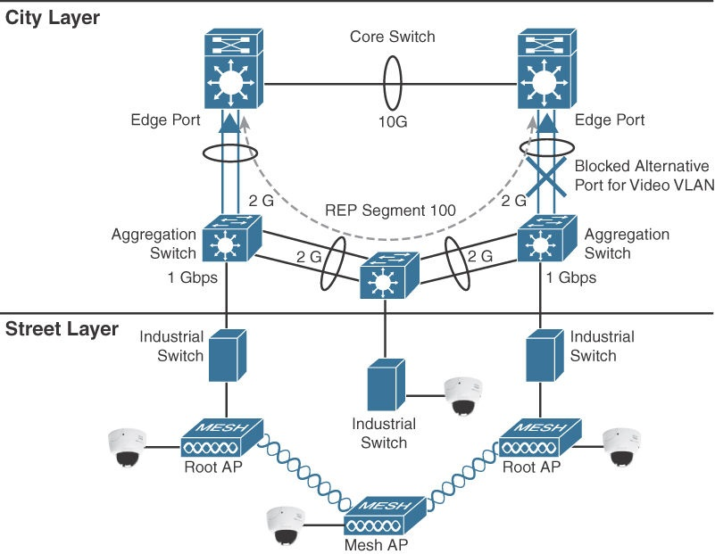

Slide 30
Smart City IoT Architecture: Data Center Layer
Data Center Layer
Ultimately, data collected from the sensors is sent to a data center, where it can be processed and correlated.
Based on this processing of data, meaningful information and trends can be derived, and information can be provided back.
Example, an application in a data center can provide a global view of the city traffic and help authorities decide on the need for more or less common transport vehicles. At the same time, an automated response can be generated. For example, the same traffic information can be processed to automatically regulate and coordinate the street light durations at the scale of the entire city to limit traffic congestion.

Slide 31
Smart City IoT Architecture: Data Center Layer
The key technology in creating any comprehensive smart solution with services is the cloud.
Data is usually stored in rented logical containers accessed through the Internet.
Because the containers can be extended or reduced based on needs, the storage size and computing power are flexible and can adapt to changing requirements or budget conditions.
The cloud model is the chief means of delivering storage, virtualization, adaptability, and the analytics know-how that city governments require for the technological mashup and synergy of information embodied in a smart city.

Slide 32
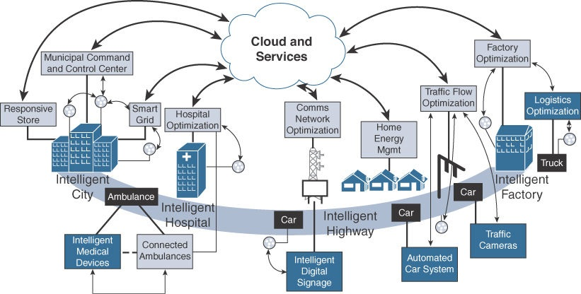
Figure 12-4 shows the vision of utilizing the cloud in smart solutions for cities. The cloud provides a scalable, secure, and reliable data processing engine that can handle the immense amount of data passing through it.

Slide 33
Smart City IoT Architecture: Data Center Layer
Not all data is processed in the central cloud-based data center.
Most of the real-time and locally significant data can be directly processed at the edge of the network, leveraging a fog architecture.
In this model, processing and analytics capabilities are made available at the top of the street layer, where gateways operate.
In this way, data coming from multiple sensors (of the same type or of multiple different types) can be processed locally at the edge.
Decisions are locally significant and can be made without unnecessary interactions with the cloud.
The results from the locally processed data are then sent to the cloud to provide a more global perspective.

Slide 34
Smart City IoT Architecture: Services Layer
“Services Layer
services use the measured data can provide to different users operating within a city.
Smart city applications can provide value to and visibility for a variety of user types, including city operators, citizens, and law enforcement.
The collected data should be visualized according to the specific needs of each consumer of that data and the particular user experience requirements and individual use cases.
For example, parking data indicating which spots are and aren’t currently occupied can drive a citizen parking app with a map of available spots,

Slide 35
Smart City IoT Architecture: Services Layer
With the architecture described in this section, a smart city can incorporate any number of applications that can consume normalized data from a cloud-hosted platform or from fog applications.
Because the entire architecture operates with compatible APIs, these applications can even enable cross-domain benefits.
Example of such cross-domain benefits, at known traffic congestion points, parking spots could be removed from availability maps, waste management routes could be properly rerouted, and street lighting could be increased. These types of cross-domain data correlations can be developed and improved by the system, inside the layered architecture, since there is a horizontal level of aggregation and normalization.

Slide 36
Smart City IoT Architecture: On-Premises vs. Cloud
A key consideration in developing ICT connectivity solutions is whether a city has requirements about where data should be hosted.
Data can be hosted on-premises or in the cloud.
Fog architectures provide an intermediate layer. The data resulting from fog processing can be sent to the cloud or to a data center operated locally (on-premises).
On-premises encompasses traditional networks, and all their limitations, whereas cloud hosting encompasses a whole host of security risks if the proper measures are not taken to secure citizen data.
cntd..

Slide 37
Smart City IoT Architecture: On-Premises vs. Cloud
When data is sent to the cloud, data sovereignty laws may restrict the physical location where this data is actually stored.
Ideally, a smart city utilizing ICT connectivity would use the cloud in its architecture, but if this is impossible, the city would need to invest far more in the city layer’s networking components (for example, switches, routers) and still may not be able to drive the same cross-domain value propositions and scalability in its design.”
a hybrid hosting approach could be implemented, whereby some data may be migrated to the cloud while other data stays on-premises.
For example, images from individual street cameras may be stored locally, while the analytics about pedestrian or car flows and the associated metadata may be hosted in the cloud.

Slide 38
Smart City IoT Architecture: Smart City Security Architecture
A security architecture for smart cities must utilize security protocols to fortify each layer of the architecture and protect city data
Security protocols should authenticate the various components and protect data transport throughout.
Ex, hijacking traffic sensors to send false traffic data to the system regulating the street lights may result in dramatic congestion issues.
The security architecture should be able to evolve with the latest technology and incorporate regional guidelines (for example, city by-laws, county or regional security regulations).
Network partners may also have their own compliance standards, security policies, and governance requirements that need to be added to the local city requirements.

Slide 39
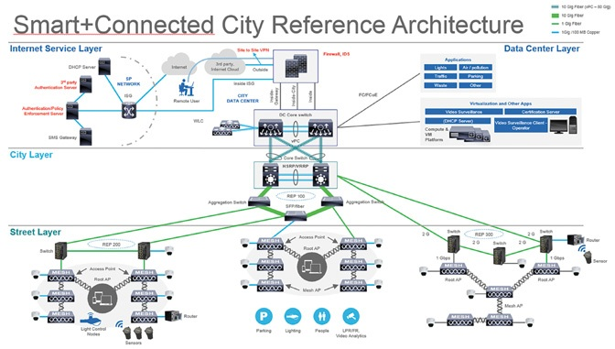

Slide 40
Smart City IoT Architecture: Smart City Security Architecture
Starting from the street level, sensors should have their own security protocols.
additional processing may slow the deployment but ensures the security of the exchanges.
the type of data that the sensor is able to collect and process drives the kind of security required..
Security considerations should determine whether this information should even be collected.
If it is collected, a decision should be made on whether this data is processed using an “online process” or a more classical analytical process (in which data is stored temporarily)
Data should be secured both at rest and in motion.

Slide 41
Smart City IoT Architecture: Smart City Security Architecture
The city layer transports data between the street layer and the data center layer. It acts as the network layer. The following are common industry elements for security on the network layer:
Firewall: A firewall is located at the edge, and it should be IPsec- and VPN-ready, and include user- and role-based access control. It should also be integrated with the architecture to give city operators remote access to the city data center.
VLAN: A VLAN provides end-to-end segmentation of data transmission, further protecting data from rogue intervention. Each service/domain has a dedicated VLAN for data transmission.
Encryption: Protecting the traffic from the sensor to the application is a common requirement to avoid data tampering and eavesdropping. In most cases, encryption starts at the sensor level. In some cases, the sensor-to- gateway link uses one type of encryption, and the gateway-to-application connection uses another encryption (for example, a VPN).

Slide 42
Smart City Use-Case Examples
Connected Street Lighting
Solution Street Lighting Architecture
Smart Parking
Smart Parking Use Cases
Smart Parking Architecture
Smart Traffic Control
Smart Traffic Control Architecture
Smart Traffic Applications
Connected Environment
The Need for a Connected Environment
Connected Environment Architecture

Slide 43
Smart City Use-Case Examples : Connected Street Lighting
Connected Street Lighting Solution
The installation of a smart street lighting solution can provide significant energy savings and can also be leveraged to provide additional services.
light-emitting diode (LED) technology leads the transition from traditional street lighting to smart street lighting:
LEDs require less energy
have a much longer life span and a longer maintenance cycle.
LED color or light intensity can be adapted to site requirements
As electricity bills rise and prices for LEDs drop, this hardware transition can open the door to a complete smart lighting solution.
A comprehensive smart lighting solution enables a converged and networked system that incorporates LED-based fixtures and dynamic lighting control, supported by the layered smart city architecture

Slide 44
Smart City Use-Case Examples : Connected Street Lighting
Connected lighting uses a light management application to manage street lights remotely by connecting to the smart city’s infrastructure.
This application attaches to LED lights, monitors their management and maintenance, and allows you to view the operational status of each light.
In most cases, a sensor gateway acts as an intermediate system between the application and the lights (light control nodes).
The gateway relays instructions from the application to the lights and stores the local lights’ events for the application’s consumption. T
The controller and LED lights use the cloud to connect to the smart city’s infrastructure, as shown in Figure 12-7.

Slide 45
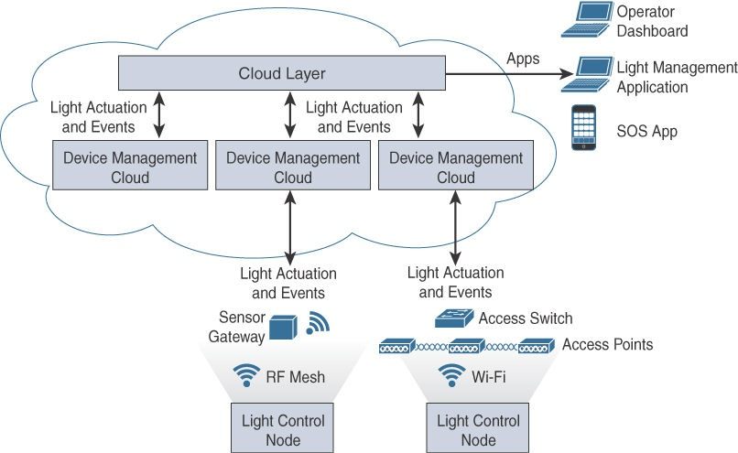
Smart City Use-Case Examples
Street Lighting Architecture

Slide 46
Smart City Use-Case Examples : Connected Street Lighting
A human or automated operator can use a cloud application to perform automated scheduling for lights and even get light sensors to perform automated dimming or brightening, as needed.
Lighting nodes vary widely in the industry, especially with respect to elements such as what communication protocol they use (for example, Wi-Fi, cellular, ZigBee, 802.15.4g [Wi-SUN], LoRaWAN), level of ruggedization, and on-board sensor capabilities.
Many solutions leverage wired connectivity, either by using the existing city cable infrastructure or by adding a cable adjacent to the power cable.

Slide 47
Smart City Use-Case Examples : Connected Street Lighting
Lighting, as an ICT connectivity solution, utilizes an existing city asset with an existing power source
The great advantage is that street lights can also become local weather reporting stations.
Functions such as monitoring power, measuring the oxygen and carbon dioxide levels, measuring the amount of pollution or particulate matter, and detecting levels of long-wave ultraviolet A (UVA) and short-wave ultraviolet B (UVB) radiation can also be added to provide additional values and services
More specialized capabilities can also be embedded, such as basic audio or video functionality with filtering and analytics to detect traffic congestion or car crashes in real time.
Municipalities often start with the energy cost savings as a primary priority and soon realize that sensors added to the already deployed IoT lighting infrastructure can add major benefits and advantages to city management.

Slide 48
Smart City Use-Case Examples : Smart Parking
Smart Parking Use Cases
Added traffic congestion is one consequence of drivers looking for parking space, and it has several consequences:
Contributes to pollution: Tons of extra carbon emissions are released into the city’s environment due to cars driving around searching for parking spots when they could be parked.
Causes motorist frustration: In most cities, parking spot scarcity causes drivers to lose patience and waste time, leading to road rage, inattention, and other stress factors.
Increases traffic incidents: Drivers searching for parking spots cause increased congestion in the streets and that, in turn, causes increased accidents and other traffic incidents.

Slide 49
Smart City Use-Case Examples : Smart Parking
Revenue loss is another consequence of drivers looking unsuccessfully for parking space, and it also has various negative side effects:
Cities often lose revenue: As a result of inadequate parking meter enforcement and no-parking, no-standing, and loading-zone violations, cities lose revenue.
Parking administration employee productivity suffers: Employees waste time roaming the streets, attempting to detect parking rules offenders.
Parking availability affects income: Local shops and businesses lose customers because of the decreased accessibility caused by parking space shortages.

Slide 50
Smart City Use-Case Examples : Smart Parking
Smart Parking Architecture
A variety of parking sensors are available on the market: in-ground magnetic; video-based sensors, and radar sensors that sense the presence of vehicles (volumetric detection).
Most sensors installed in the ground must rely on battery power, since running a power line is typically too expensive.
In high-density environments (for example, indoor parking, parking decks), one or several gateways per floor may connect to the parking sensors, using shorter-range protocols such as ZigBee or Wi-Fi.
The gateway may then use another protocol (wired or wireless) to connect to the control station.
In larger (for example, outdoor) environments, a longer-range Low Power Wide Area (LPWA) protocol is common, as shown in Figure 12-8.

Slide 51
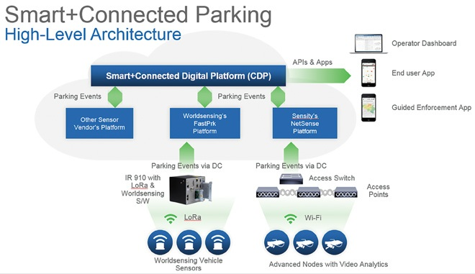

Slide 52
Smart City Use-Case Examples : Smart Parking
parking sensors are typically event-driven objects.
A sensor detects an event and identifies it based on time or analysis.
The event is transmitted through the device’s communication protocol to an access point or gateway, which forwards the event data through the city layer.
The gateway sends it to the cloud or a fog application, where it is normalized.
An application shows the parking event on operator dashboards, or personal smart phones, where an action can be taken.

Slide 53
Smart City Use-Case Examples : Smart Parking
For example, a driver can book a nearby parking spot, or a parking operator can remove it from the list of available parking spaces in target locations. This action triggers data to be sent back to the parking sensor to modify its availability status based on the received instructions. In turn, the sensor may interact with nearby systems.
For example, in response to these instructions, lights above parking spaces can be turned red, orange, or green to display a free, booked, or occupied spot, thus facilitating a driver’s search for an available parking spot.
Similarly, a parking sensor can send a status to a general parking spot counter at the entrance of the parking deck to display how many spots are available in a given area, such as on a particular floor of a parking deck.
This communication may be direct but often goes through a gateway, the network, and the application that communicates with the other systems through APIs. The user may also access the data from the cloud or fog-based applications to see the list of spots available in a particular city district or neighborhood. Smart data can also be embedded—for example, to increase the discount on more distant parking spots or increase the cost of parking spots closer to venues at particular times (such as sporting events or concerts).

Slide 54
Smart City Use-Case Examples : Smart Parking
The following are some potential user experiences for these three user types:
City operators:
want a high-level map of parking in the city to maintain perspective on the city’s ongoing parking situation. They would also need information on historical parking data patterns to understand congestion and pain points in order to be able to effectively influence urban planning.
Parking enforcement officers: These users might require real-time updates on parking changes .Their focus is driving revenue creation for the city and minimizing monitoring time.
Citizens: want an application with a map (such as a built-in parking app in their car) showing available parking spots, reservation capabilities, and online payment.

Slide 55
Smart City Use-Case Examples : Smart Traffic Control
Smart Traffic Control Architecture
In the architecture shown in Figure 12-9, a video analytics sensor computes traffic events based on a video feed and only pushes events (the car count, or metadata, not the individual images) through the network.
These events go through the architectural layers and reach the applications that can drive traffic services.
These services include traffic light coordination and also license plate identification for toll roads.
Some sensors can also recognize abnormal patterns, such as vehicles moving in the wrong direction or a reserved lane. In that case, the video feed itself may be uploaded to traffic enforcement agencies.
Other types of sensors that are part of traffic control solutions include Bluetooth vehicle counters, real-time speed and vehicle counters, and lighting control systems.
These sensors provide a real-time perspective while also offering data collection services for historical data trending and correlation purposes.

Slide 56
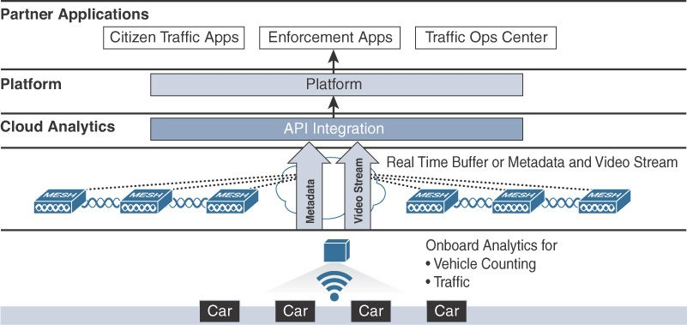
Figure 12-9 Smart City Traffic Architecture

Slide 57
Smart City Use-Case Examples : Smart Traffic Control
Smart Traffic Applications
Traffic applications can be enabled to take immediate action with other sensors to manage traffic and to reduce pain points.
Historical data can be used to develop more efficient urban planning to reduce the amount of traffic a city experiences.
A well-known remedy for stop-and-go traffic is to regulate the standard flow speed based on car density. As density increases, car speed is forced down to avoid the wave effect.
An application that measures traffic density in real time can take action by regulating the street light cycle duration to control the number of cars added to the flow of the main routes, thus limiting or suppressing the wave effect.
From the driver’s standpoint, there is a wait time before being able to get on the highway or main street, and traffic on the main route is slow but steady.

Slide 58
Smart City Use-Case Examples : Smart Traffic Control
Smart Traffic Applications
Information can also be shared with drivers.
Countless applications leverage crowd sourcing or sensor-sourced information to provide real-time travel time estimates, suggest rerouting options to avoid congestion spots, or simply find the best way between two points, while taking into account traffic, road work, and so on.
information; specifically, waste, parking, lighting, and environment can all drive traffic outcomes.

Slide 59
Smart City Use-Case Examples : Connected Environment
The Need for a Connected Environment
To fully address the air quality issues in the short term and the long term, a smart city would need to understand air quality on a hyper-localized, real-time, distributed basis at any given moment. To get those measurements, smart cities need to invest in the following:
Open-data platforms that provide current air quality measurements from existing air quality monitoring stations
Sensors that provide similar accuracy to the air quality stations but are available at much lower prices
Actionable insights and triggers to improve air quality through cross- domain actions
Visualization of environmental data for consumers and maintenance of historical air quality data records to track emissions over time

Slide 60
Smart City Use-Case Examples : Connected Environment
Connected environment sensors might measure different gases, depending on a city’s particular air quality issues, and may include weather and noise sensors. These sensors may be located in a variety of urban fixtures, such as in street lights, or embedded in the ground or in other structures or smart city infrastructure or through connected wearables
Crowdsourcing may make this information available to the global system.
Communication technologies depend on the location of the sensors.
Independent and standalone sensors typically use wireless technologies.
Ex. in urban environments, ZigBee and Wi-Fi are common. In larger environments, LPWA technologies, such as NB-IoT and LoRaWAN, are used.

Slide 61
Smart City Use-Case Examples : Connected Environment
In addition to all the air quality sensor and wearable data, the data center layer or application layer represented on the left side of Figure 12-10 also receives the open data from existing weather stations as an additional data input.
All these data inputs come together to provide a highly accurate sense of the air quality in the city at any given moment.
This information can be visualized in applications that include heat maps of particulates, concentrates, and specific information on the dangers of such gaseous anomalies.
Different pollution levels can be communicated, and gases can be tracked as they move throughout the city, either because of the wind or because of the movement of gas sources

Slide 62
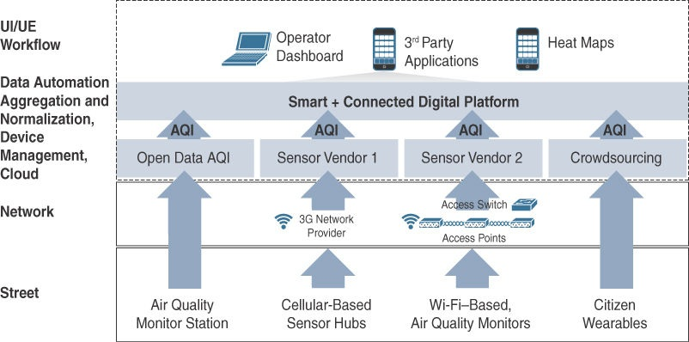
Figure 12-10 Connected Environment Architecture

Slide 63
Smart City Use-Case Examples : Connected Environment
From this pollution and environmental data and the analytics applied to it, the city can track problem areas and take action in long-term urban planning to reduce the effects of air quality disturbances.
Ex. increasing public transit availability along the more polluted routes to encouraging the displacement of businesses toward living areas to limit the need to commute daily.
Ex. citizens can turn on their air purifiers at a given moment or simply stepping inside if pollutant concentrations are becoming serious.
Ex. Strategic coordinated joint actions, restricting traffic along certain routes or on certain days, and encouraging citizens to share vehicles or use the public transportation system.

